Slide 1
Asia-Pacific Conference on Computer Science and Data Engineering
Shangir-La’s Fijian Resort Fiji
04-06th December 2023
Jany Smith
University of Technology
Lautoka, Fiji
Email: j.smith@uot.edu
@ IEEE CSDE 2023

Slide 2
Presentation Outline
01
02
03
04
05
06
07
08
Introduction
Research Goal
Research Update - Untill Today
Research Question/s
Proposed Solutions
Experimenatl Outcome
Our Findings
Conclusions and Where to Go!

Slide 3
Introduction
Please introduce your research here

Slide 4
Research Goal
Summary of goal
01
02
03
04
Drive .......
Increase ........
Increase ......
Acquire .........

Slide 5
Research Update - Untill Today
Property &
Real Estate
Engineering & Manufacturing
Tech Industry
Keep the body text short
— 3 lines or less is good
Keep the body text short
— 3 lines or less is good
Keep the body text short
— 3 lines or less is good
Food & Beverage
Retail & Merchandising
Education & NGOs
Keep the body text short
— 3 lines or less is good
Keep the body text short
— 3 lines or less is good
Keep the body text short
— 3 lines or less is good

Slide 6
Research Question/s

Slide 7
Proposed Solutions

Slide 8
Competitor Analysis
Company A
Company B
Company C
Price Range
App Available
USP
Strengths
Weaknesses
$0 -$100 (monthly)
Unique Selling Point here
List strength one here
List strength two here
List strength three here
List weakness one here
List weakness two here
List weakness three here
$0 -$100 (monthly)
Unique Selling Point here
List strength one here
List strength two here
List strength three here
List weakness one here
List weakness two here
List weakness three here
$0 -$100 (monthly)
Unique Selling Point here
List strength one here
List strength two here
List strength three here
List weakness one here
List weakness two here
List weakness three here

Slide 9
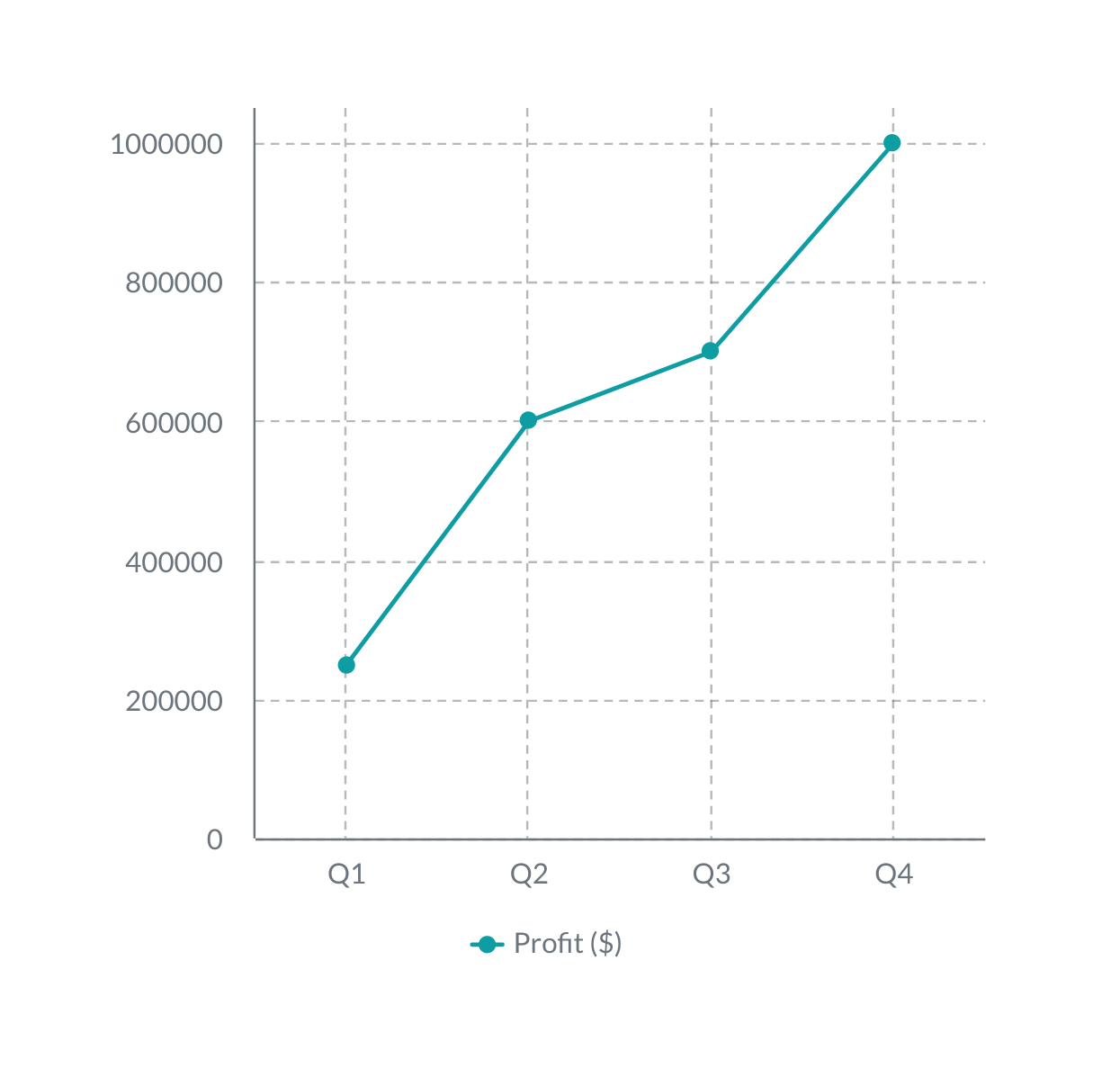
More Result Analysis
In order to convince your stakeholders, we recommend stating the current state or system.
Activity
SEO
Advertising
PR
New Subscriptions
TOTAL
Budget
$20,000
$30,000
$50,000
$10,000
$110,000

Slide 10
Our Findings
Top Target
Moderate
01
02
03
04
05
06
Launch Newsletter
List action
item 1 here
List action
item 2 here
List action
item 3 here
List action
item 1 here
List action
item 2 here
List action
item 3 here
List action
item 4 here
List action
item 1 here
List action
item 2 here
List action
item 3 here
List action
item 1 here
List action
item 2 here
List action
item 1 here
List action
item 2 here
List action
item 3 here

Slide 11
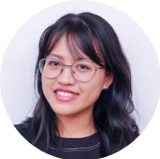
Reach out if you have any questions!
thank
you
Prepared by:
Jany Smith, PhD Candiadte

